Slide 1

Software Architecture
SSE USTC Qing Ding
dingqing@ustc.edu.cn
http://staff.ustc.edu.cn/~dingqing

Slide 2

MVC, MVP and MVVM: A Comparison of Architectural Patterns

Slide 3
Overview
What, why, how of Model-view-controller(C) or presenter(P) or View Model(VM) architecture patterns
Model-View-Controller (MVC) pattern
Model-View-Presenter (MVP) pattern
Model-View-ViewModel (MVVM) pattern

Slide 4
Overview of MVVM
“Traditional” Windows Presentation Foundation(WPF) Programming

Slide 5
Overview of MVVM
Traditional WPF View Architecture
View
XAML
(UI layout)
Model
(domain objects)
updates, may observe
Code Behind

Slide 6
Overview of MVVM
XAML: window layout + named controls
<StackPanel>
<TextBox x:Name=“City” />
<ComboBox x:Name=“CountryList” SelectionChanged=… />
</StackPanel>
Code behind: event handlers and manipulating the controls
void CountryList_SelectionChanged(…)
{
City.Text =
GetCity(CountryList.SelectedItem as Country);
}

Slide 7
Overview of MVVM
Pros and Cons of the Traditional Model:
Simplicity
Power: manipulate controls as you please
Difficult to Test
Cannot easily identify modifiable UI state
Encourages using UI as data storage
Encourages mixing business logic and control manipulation

Slide 8
Overview of MVVM
What is MVVM

Slide 9
Overview of MVVM
Model does not know anything about the UI
View is a UI element (e.g. a Window)
“Something” somehow fills the gap
Model
View
Something
Controller?
Presenter?
Code Behind?

Slide 10
What is Model/View/(C or VM or P)
Patterns that describe a modular approach to
software development
Modules include:
  Model – Data
  View – Presentation Layer
  C or VM or P – Glue Logic
They are based upon a “Separation of Duties”
  Seen in many other types o,f system frameworks
How is this different from nTier development in the 90’s - anybody remember Distributed interNet Architecture (DNA)

Slide 11
Why Model-View-(C or VM or P)
The Patterns all have similar goals, however, achieve
them in different ways
The Patterns goals are to increase:
  Modularity
  Flexibility
  Testability
  Maintainability

Slide 12
Model-View-Controller (MVC)
First described in 1979 for Smalltalk at Xerox PARC
Controller is centerpiece that decouples the Model
and View
Control flow:
  User interaction event
  Controller handles event and converts it to a user action the Model can understand
  Model manages the behavior and data of the application domain
  The View interacts with the Controller and Model to generate a user interface

Slide 13
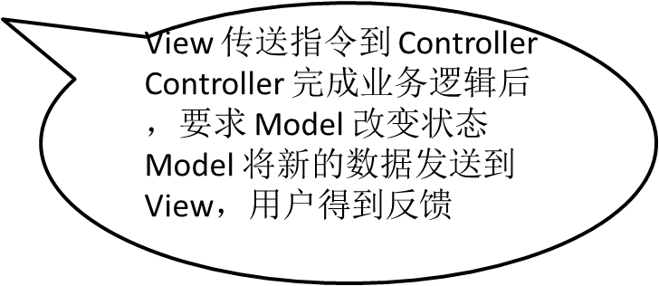
1979: Model View Controller
I've lost count of the times I've seen something described as MVC which turned out to be nothing like it.
Martin Fowler
Model
(domain objects)
View
(output)
observes
changes
may update
Controller
(input)
http://martinfowler.com/eaaDev/uiArchs.html

Slide 14
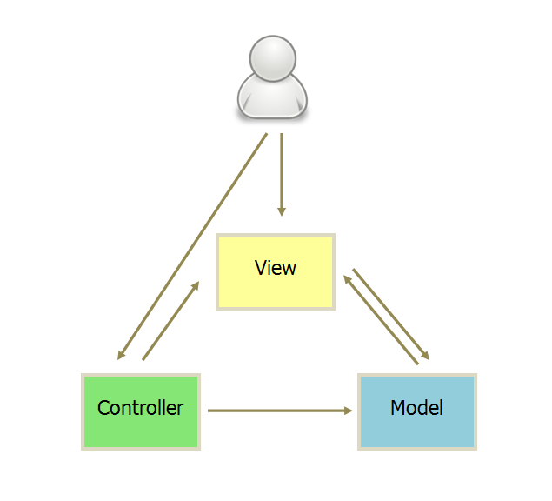
Backbone.js
1. 用户可以向 View 发送指令（DOM 事件），再由 View 直接要求 Model 改变状态。
2. 用户也可以直接向 Controller 发送指令（改变 URL 触发 hashChange 事件），再由 Controller 发送给 View。
3. Controller 非常薄，只起到路由的作用，而 View 非常厚，业务逻辑都部署在 View。所以，Backbone 索性取消了 Controller，只保留一个 Router（路由器） 。

Slide 15
MVC Observer Pattern
Controller
View
Model

Slide 16
Client/Server (DNA) vs MVC
Client
-----------------------
Business Objects
Controller
Server
-----------------------
Business Objects
Data
View
Model

Slide 17
Model-View-Presenter (MVP)
MVP originated in early 1990s
MVP is a derivative of MVC
Two types of implementation
  Passive View
  Supervising Controller
Presenter assumes the functionality of the MVC Controller
View is responsible for handling UI events
Model becomes strictly a Domain Model
More User Interface centric

Slide 18
Passive View
Model
(domain objects)
Passive View
(input, output)
updates, may observe
observes, updates
Presenter
(all presentation logic)
http://martinfowler.com/eaaDev/PassiveScreen.html

Slide 19
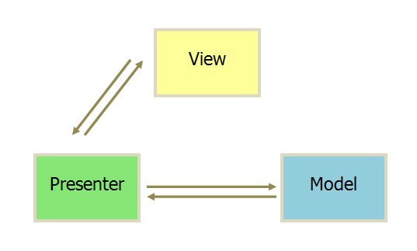
MVP
1. 各部分之间的通信，都是双向的。
2. View 与 Model 不发生联系，都通过 Presenter 传递。
3. View 非常薄，不部署任何业务逻辑，称为"被动视图"（Passive View），即没有任何主动性，而 Presenter非常厚，所有逻辑都部署在那里。

Slide 20
MVC vs MVP (Passive)
Controller
Presenter
View
Model
View
Model

Slide 21
MVP – Supervising Controller Pattern
Presenter
View
Model

Slide 22
2004: Model View Presenter (supervising controller)
Model
(domain objects)
View
(input, output)
observes
updates,
may observe
observes, may update
Presenter
(complex
presentation logic)
“Let the view handle as much as possible and only step in when there's more complex logic involved.”
http://martinfowler.com/eaaDev/SupervisingPresenter.html

Slide 23
Presentation Model
Model
(domain objects)
View
(input, output)
updates, may observe
synchronizes state with
Presentation Model
(UI state)
Presentation model contains all variable UI state in a UI-agnostic manner
The most annoying part of Presentation Model is the synchronization. Ideally some kind of framework could handle this... like .NET's data binding.
http://martinfowler.com/eaaDev/PresentationModel.html

Slide 24
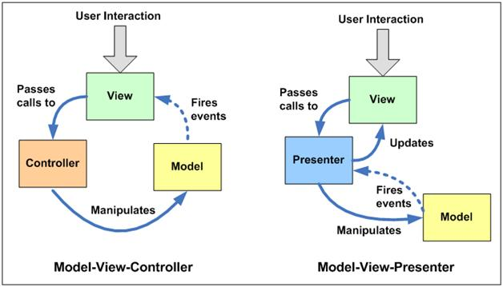
Compared to…

Slide 25
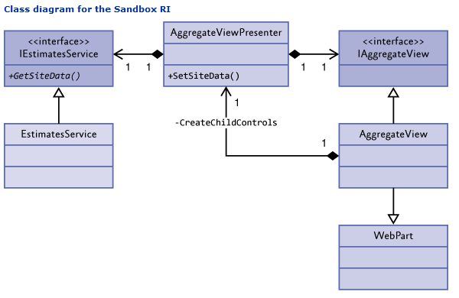
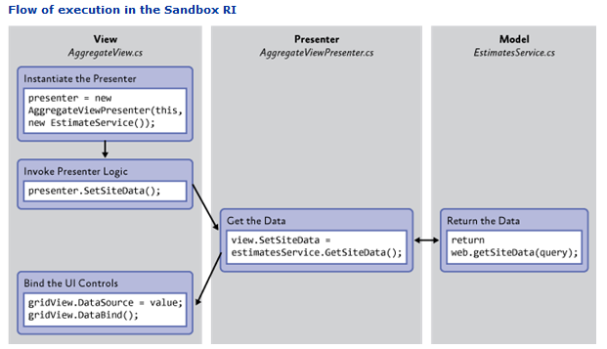
SharePoint 2010 Developer Guidance
MVP Class Diagram and Flow of Execution for the SandBox Execution Model

Slide 26
Model-View-ViewModel (MVVM)
Largely based on MVC
Specialization of the MVP pattern known as the Presentation Model
Built specifically for the WPF and Silverlight environments
Model and View works just like MVC
ViewModel is a “Model of the View”
  It extends the Model with Behaviors the View could use
  Data Binding between View and Model
  Passes commands between the View and Model

Slide 27
MVP (Passive) vs MVVM
Presenter
ViewModel
View
Model
View
Model

Slide 28
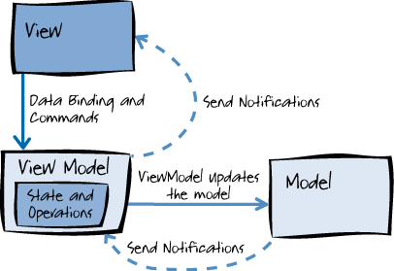
The MVVM Pattern
Components can be swapped out
Internal implementation can be changed without affecting other components.
Components can be worked on independently
Isolated unit testing
采用双向绑定（data-binding）：View的变动，自动反映在 ViewModel，反之亦然。Angular 和 Ember 都采用这种模式。
Notes:
View knows about View Model, View Model knows about the Model, but the Model is unaware of view model and view model unaware of the view.
Send out messages/ events to communicate backwards.

Slide 29
How Do We Achieve that?
View
ViewModel
Model

Slide 30
A More Complete Diagram
Unit Tests
Integration Tests
View
XAML, Code Behind
Behavior
Actions
Bindings
ViewModel
Properties, Commands, View Logic
Data
Events
Model
Service Proxies
Web

Slide 31
MVVM – The View
Defines structure, layout and appearance.
Only knows about the View Model.
Ideally it is pure XAML with little to no code behind.
Can have it’s own View Model or inherit from its parent.
At runtime, UI responses to View Model properties raising change notification events.
A view on Windows Phone is typically a page in the application.

Slide 32
MVVM – The Model
This is your domain model.
Includes business and validation logic.
Examples: Repositories, business objects, data transfer objects (DTOs), value objects etc.
Only knows about itself – not the views, controllers etc.

Slide 33
MVVM – The View Model
Intermediary between View and the Model.
Only knows about the Model.
Handles view logic.
Interacts with Model by invoking methods in the model classes.
Provides the data from model in a form that the view can use.
Provides command implementations that the view uses.
  Example: Clicking a button on the UI triggers a command in the View Model.
Defines state.

Slide 34

Mini Patterns

Slide 35
NotifyPropertyChanged
public interface INotifyPropertyChanged
{
event PropertyChangedEventHandler
PropertyChanged;
}

Slide 36
Command Pattern
public interface ICommand
{
bool CanExecute(object param);
void Execute(object param);
event EventHandler CanExecuteChanged;
}
public class DelegateCommand : ICommand
{
public DelegateCommand(
Action<object> command,
Predicate<object> canExecute);
}

Slide 37
Event Aggregator Pattern

Slide 38
Attached Behaviors
<TextBlock Foreground=“Red” Width=“200” Behaviors:Update.WhenTextChanged=“True”
/>
TextBlock
FontSize
Foreground
Width
…
Trimming
Behavior

Slide 39
MVVM Guidelines
1. Reduce or eliminate your code-behind
2. Bind all of your UI inputs/outputs to your ViewModel
3. Implement INotifyPropertyChanged on your ViewModel
4. Put your view behavior into the ViewModel
5. Do not put any view state into the model
6. Only bind to a model object if there is no view-specific info
7. When testing, treat ViewModel as the Real UI
8. Avoid events. Use commands instead

Slide 40
Third Party Support
Prism
MVVM Light
Caliburn
Silverlight FX

Slide 41
MVVM – The Benefits
Enables developer-designer workflow.
Developers and designers can work independently and concurrently on their components.
Developers can create unit tests without the need for the View.
You can redesign the UI without touching the code.
View Model acts as an adapter and allows changes to the model more easily.
Notes:
If designers are using Expression Blend, they can easily generate sample data to work with

Slide 42
MVVM vs MVC vs MVP - Controllers
Controller determines which view is displayed.
Events in the View trigger actions in the controller.
Multiple Views for each controller.
Example: ASP.NET MVC Website

Slide 43
MVVM vs MVC vs MVP - Presenters
2-way communication with the view.
View calls functions on an instance of the presenter.
Presenter talks to an interface implemented by the view.
Single presenter for each view.
Example: Windows Forms.
NOTE: Not going into detail as I have never used MVP.

Slide 44
MVVM vs MVC vs MVP - ViewModels
Again – 2-way communication with view.
ViewModel represents the View.
Matches up more closely with the View rather than the Model.
View binds directly with View Model.
Changes in the View are reflected automatically in the View Model and visa-versa.
Single ViewModel for each View.
Examples: WPF, XAML, Knockoutjs

